Slide 1




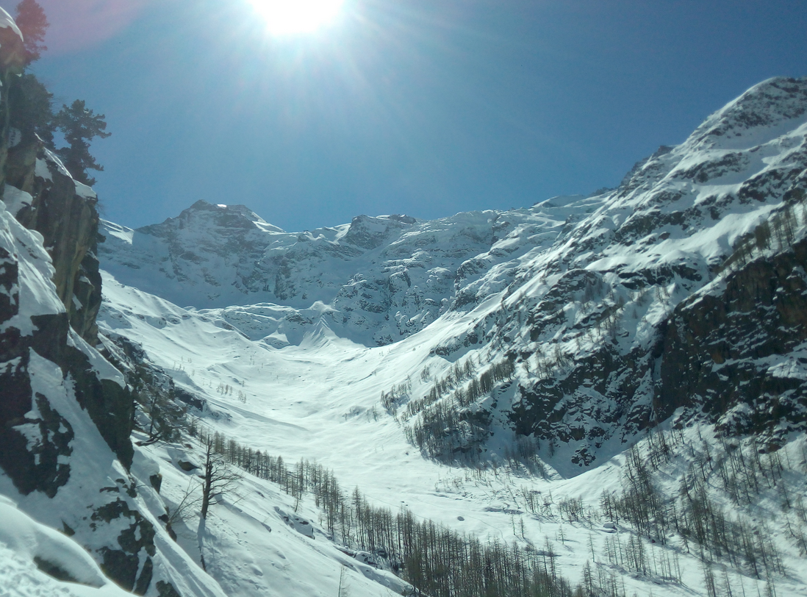



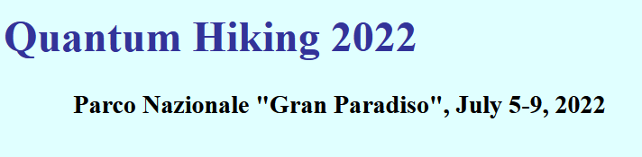
A Quantum Model
for Numerosity Perception
Marilù Chiofalo
Department of Physics «Enrico Fermi»
University of Pisa

Slide 2
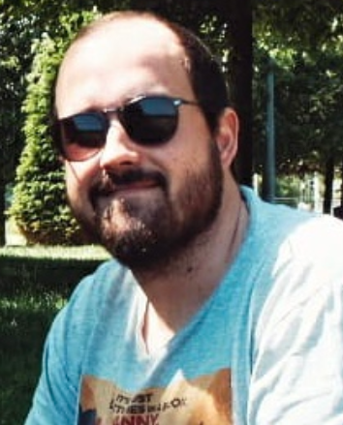
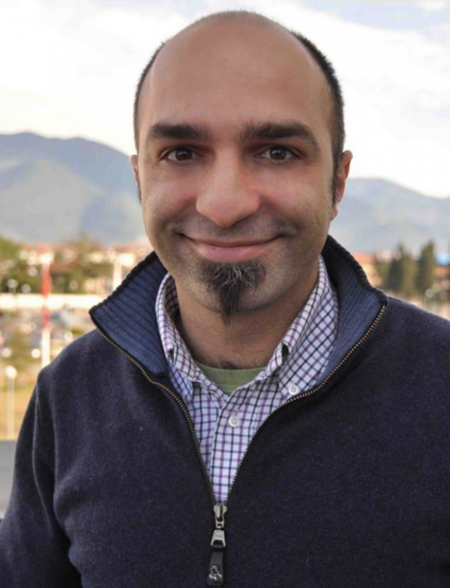


Jorge Yago
Malo
Department of Physics
University of Pisa
See Poster!!!
Guido Marco Cicchini
Institute of Neuroscience
CNR-Pisa
PisaVisionLab
Maria Concetta Morrone
Department of Translational Research and of New Surgical and Medical Technologies
University of Pisa
PisaVisionLab

Slide 3
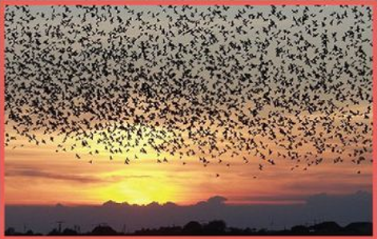
Numerosity perception: phenomenology

Slide 4
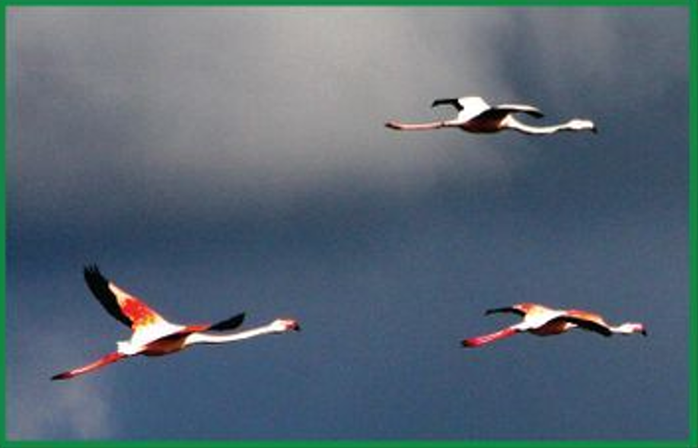
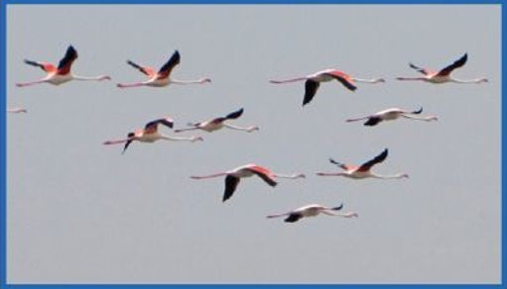
Humans (and animals) are able to estimate pretty well HOW MANY objects there are
i.e. their numerosity
Humans perform this operation remarkably well with an error rate of about 20% over 7-200 range of items
Determining number is traditionally associated with counting
In fact: PERCEPTUAL FUNCTION (not cognitive)
«Analogic sense of number»
D. Burr, J. Ross, A visual sense of number. Curr. Biol. 18, 425–428 (2008)

Slide 5
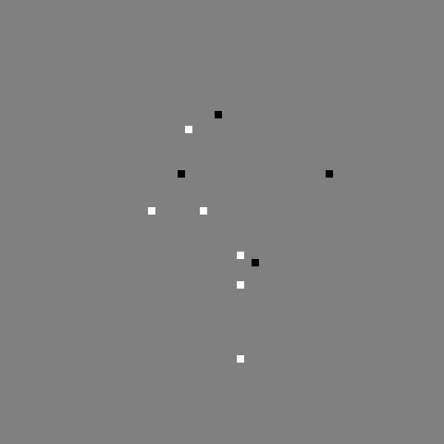
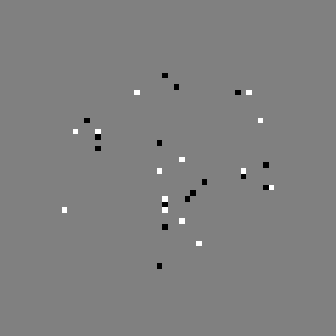
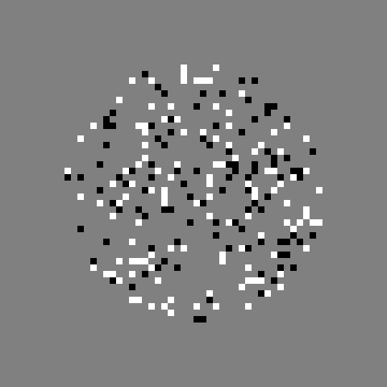
Pls fixate RED DOT
Courtesy of Dave Burr
Where did dots go? Left or right?

Slide 6
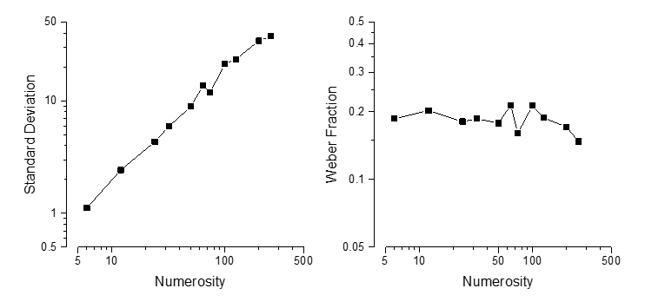

  WEBER’s LAW
  A random counter would at most be Poissonian ( )
$$\sqrt{N}$$
  ! HOLDS OVER A WIDE RANGE OF STIMULI # !
Exp data from PisaVisionLab: Anobile, Turi, Cicchini, Burr, Journal of Vision (2015)

Slide 7
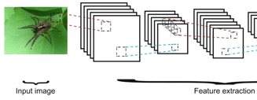
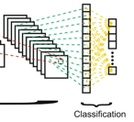
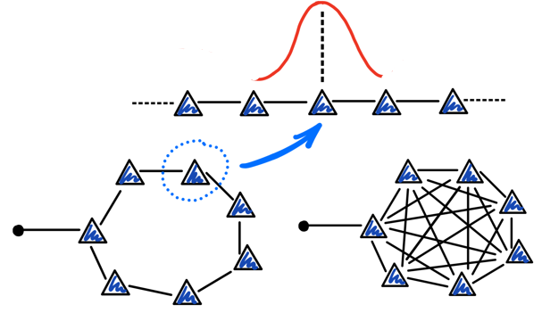
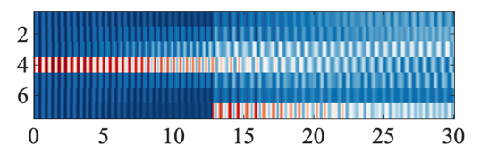
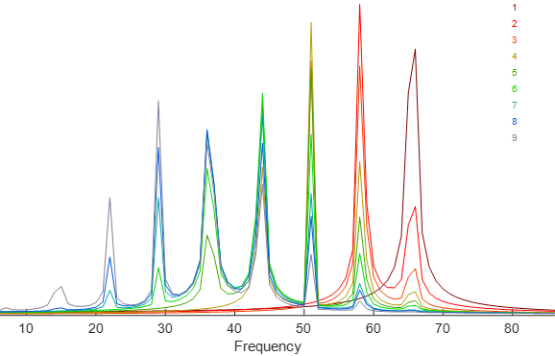
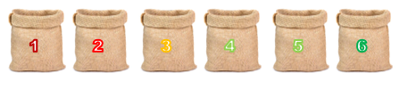
Numerosity perception:
existing models
Our coarse-grained
quantum model
Methods
Numerosity perception: phenomenology
Results

Slide 8
Numerosity perception:
existing models
Our coarse-grained
quantum model
Methods
Numerosity perception: phenomenology
Results

Slide 9
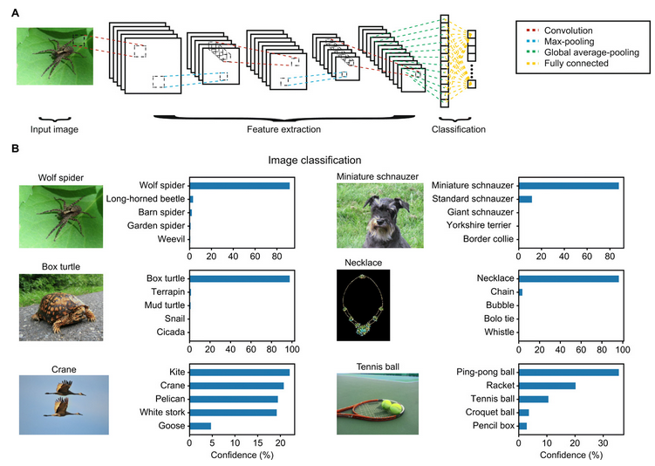
8 Convolutional layers = local filtering
5 Pooling layers =aggregated response
AlexNet
A bio-inspired network tuned to provide
high-performance image classification
Krizhevsky, Sutskever, Hinton, ImageNet classification with deep convolutional neural networks, in Adv. in Neural Information Processing Systems 25 (NIPS 2012)
Nasr, Viswanathan, Nieder, Science Advances, 5(5) (2019)

Slide 10
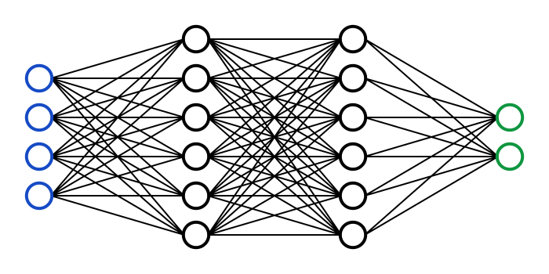
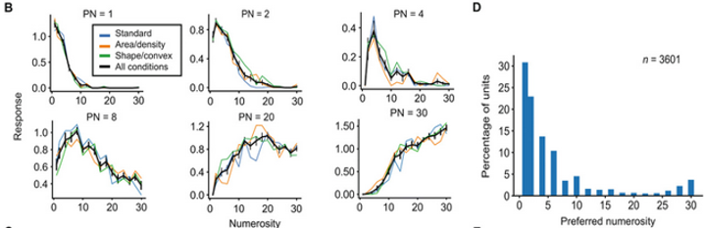
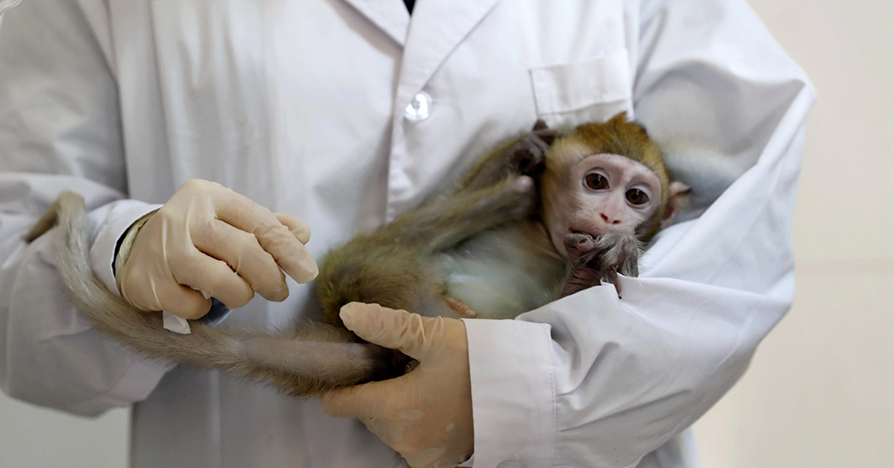
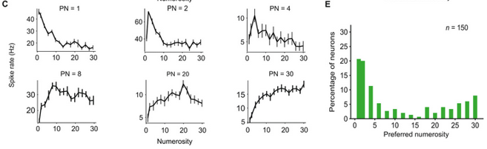
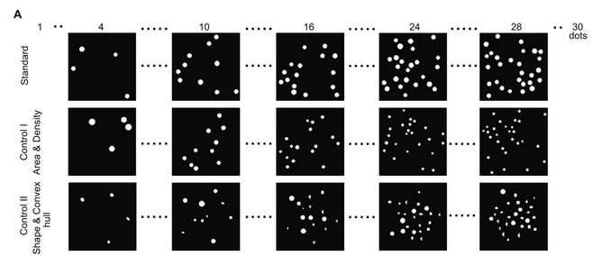
Numerosity is encoded by (at best) 9.6% of units
+ Weber’s law
Nasr, Viswanathan, Nieder, Science Advances, 5(5) (2019)

Slide 11
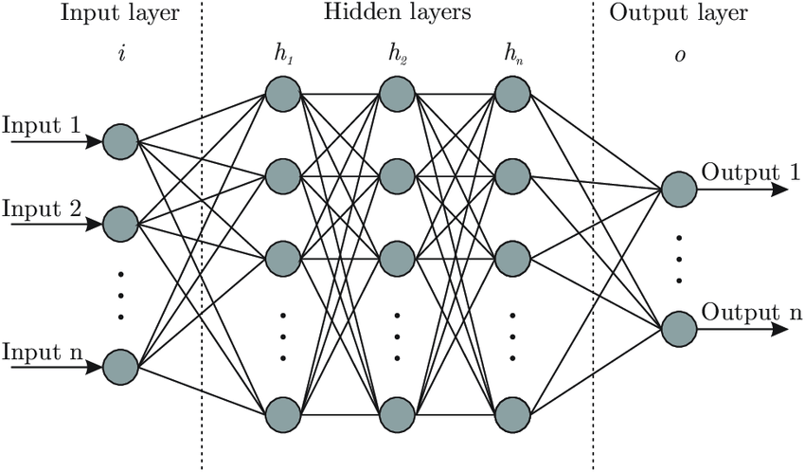
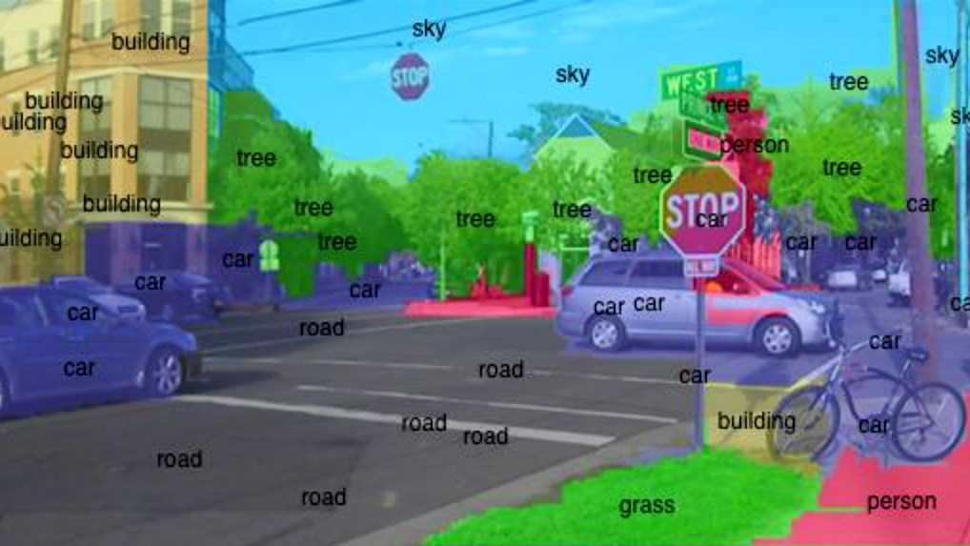
Existing network models accounting for numerosity perception:
Are characterized by complex and involved architectures
Are designed and trained for specific tasks
Anyway, the task of counting numerosity is accomplished only by a limited number of nodes (it is a local property)
MESSAGE

Slide 12
IS BRAIN USING AN AD HOC MECHANISM FOR NUMEROSITY PERCEPTION?
Is there a dedicated model able to describe this function and related Weber’s law?
Is this function «universal», i.e. an inherent property of the network: robust with respect to space and time randomness, and dissipation?
Can we extract this property from the global response of our system, rather than from the behaviour of single nodes or a small subset of them, so not just – say – 10%?
R QUESTIONS

Slide 13
Numerosity perception:
existing models
Our coarse-grained
quantum model
Methods
Numerosity perception: phenomenology
Results

Slide 14
One different approach

Slide 15
CONCEIVING A COARSE-GRAINED BRAIN QUANTUM MODEL
0) Modelling the information
1a) Modelling neurons as non linear filters
1b) Modelling the network of filters (neural networks)
2) Modelling the neuronal architecture
3) Modelling the microscopic biophysics and chemistry mechanisms
Levels of description from existing approaches:
VERY COARSE GRAINED!!!!!!
! QUANTUM AS A TOOLBOX !

Slide 16
Main ingredients:
Neuron: activity vs no activity
Propagation of activity
Built-in connectivity of the network with excitatory and inhibitory mechanisms (receptive field/inhibitory surrounds)
Flexibility in modelling connectivity of neighbors for different functions
System decays to a resting state
Quantum physical modelling:
Quantum system: spin (up/down)
Excitation transfer via tunneling
Interaction potential between nodes
From nearest-neighbor to all-to-all coupling
Presence of dissipation

Slide 17
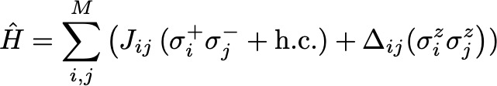



Tunneling
Connectivity
Interaction: Receptive field modelled with Gaussian profile
vs
$$∆_{ij}≈exp⁡[−{(i−j)]}^{2}/(2 α^{2})]$$
+ Dissipative terms: losses - excitation exits the system
dephasing - limiting quantum coherence times
(Long-range) XXZ model: paradigmatic with well-known properties @ equilibrium
C.N. Yang and C. P. Yang, Phys. Rev. (1966)
What about dissipative systems far from equilibrium with no non-trivial stationary states?

Slide 18
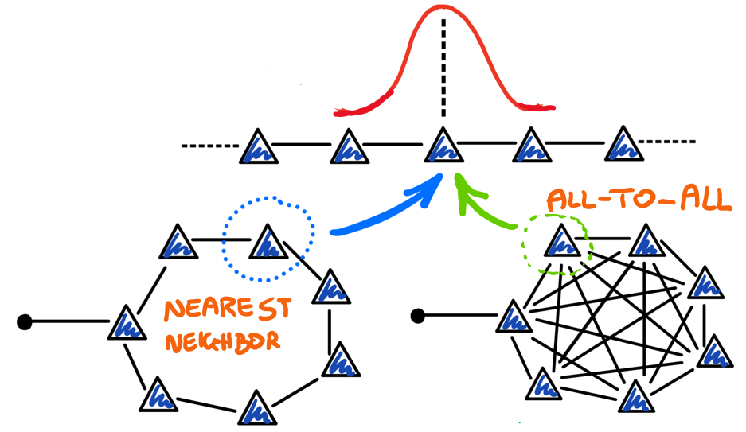

Slide 19
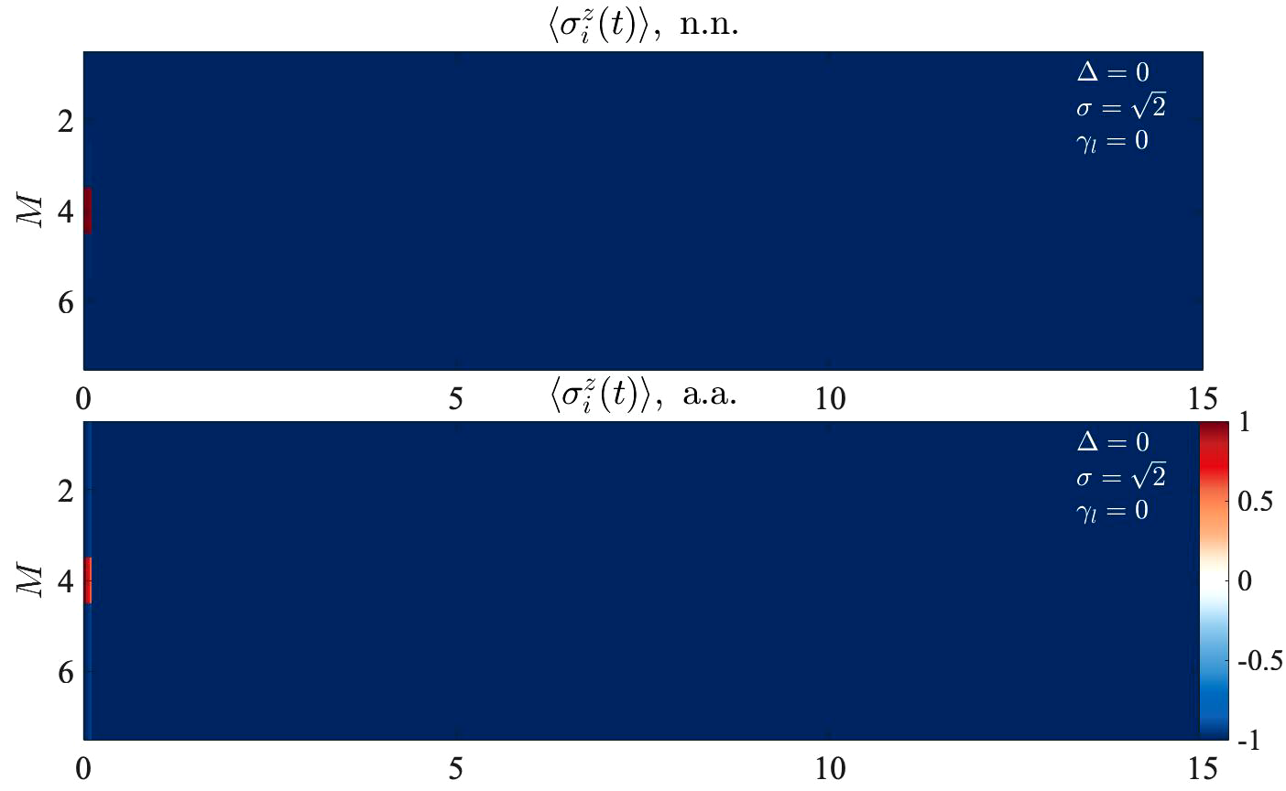
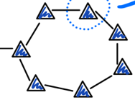
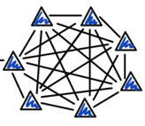
Intuition
Building

Slide 20
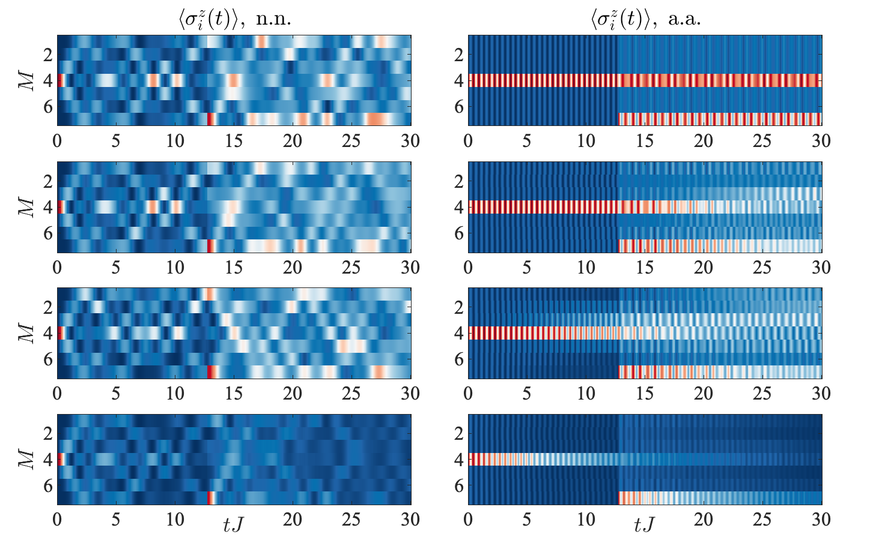
ADDING MORE EXCITATIONS
nearest neighbors all-to-all
Tunneling
Tunneling and interaction
Wider interaction
Tunneling, interaction and
particle loss
Recognize several frequencies in the system

Slide 21
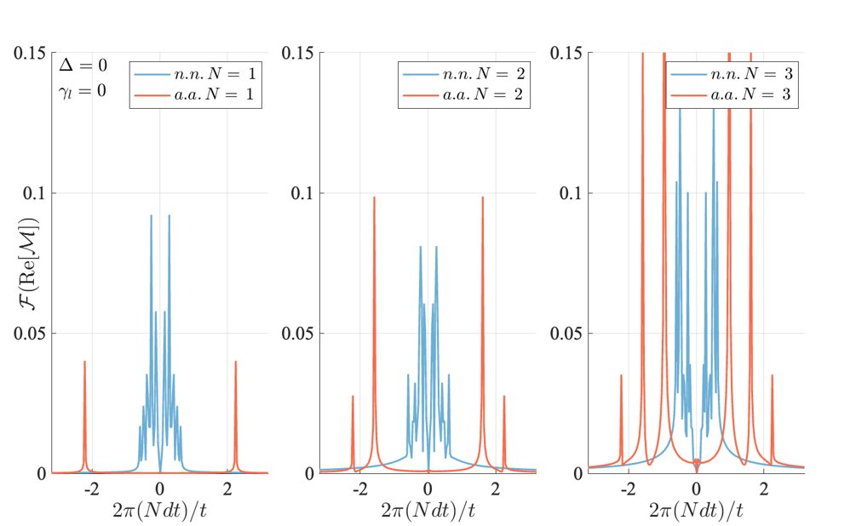
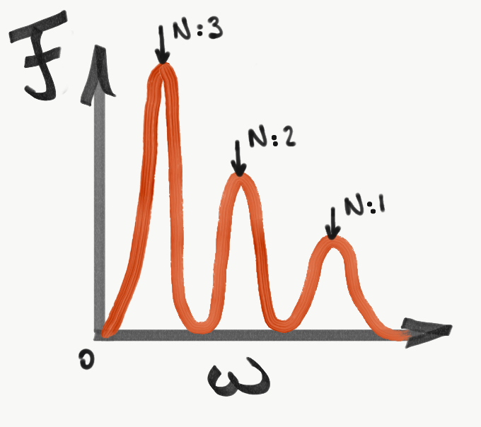
IN ALL TO ALL CONNECTIVITY THE CLOCK COUNTS # EXCITATIONS

Slide 22
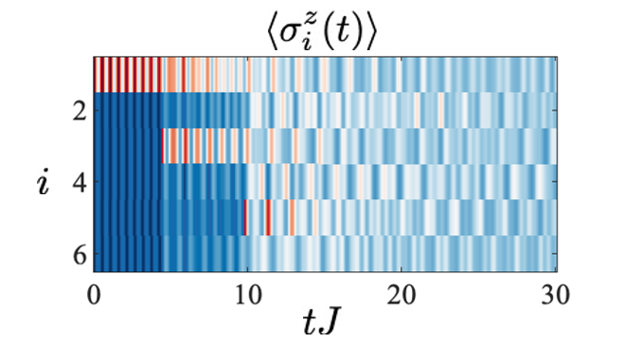
SIGNAL OF PAST EVENTS PERSISTS AFTER LONG TIME EVEN IN THE PRESENCE OF DISSIPATION
M. Chiofalo, J. Yago Malo, G. Cicchini, C. Morrone, Mind and Matter 2021 – The Kankas Symposium
t=0 t1 t2

Slide 23
Numerosity perception:
existing models
Our coarse-grained
quantum model
Methods
Numerosity perception: phenomenology
Results

Slide 24
An agnostic strategy
PROTOCOL

Slide 25
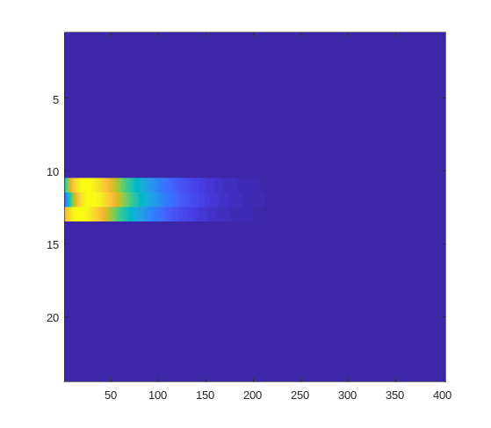
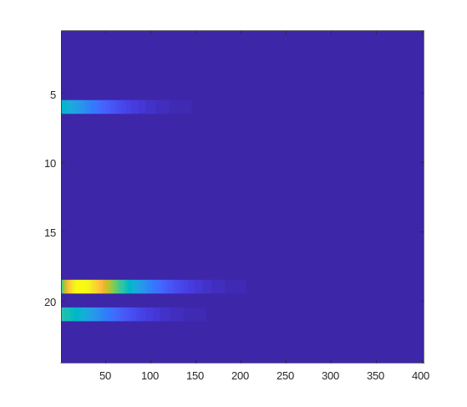
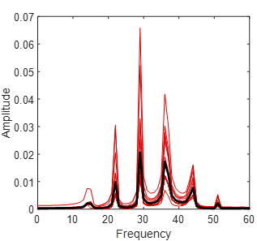
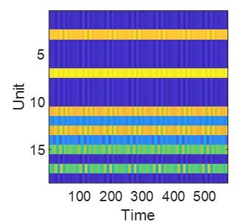
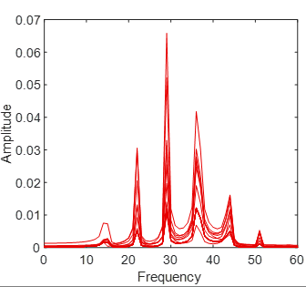
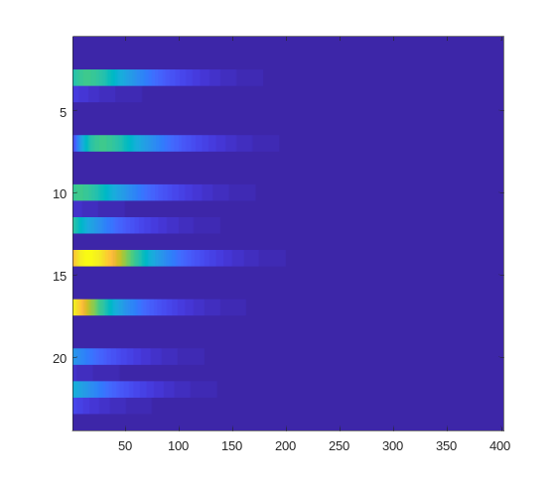
1 – Spectral analysis of time-evolving magnetization+ spatial ave across sites
Fourier analysis
@each spatial site
t-evolving magnetization
N=2
200 trajectories
N=…
200 trajectories
……………………..
N= 9
200 trajectories
averaged across sites

Slide 26
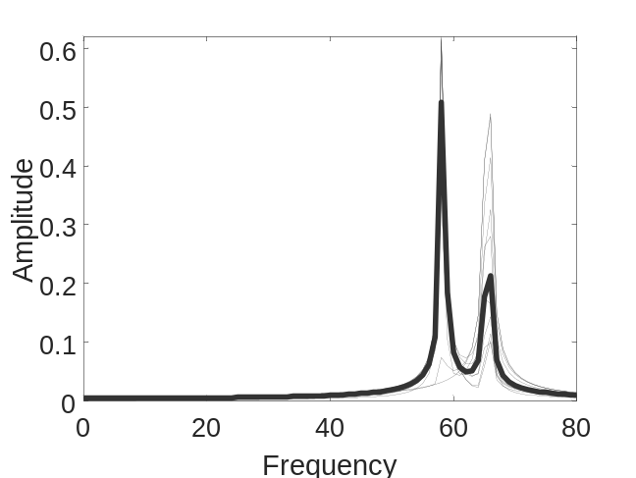
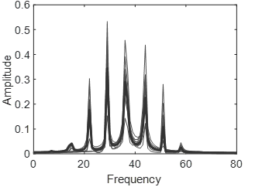
2 – Template building: Average spectrum across trajectories
Example: N=2
200 trajectories
3 – Library of templates
Example: N=8
200 trajectories

Slide 27
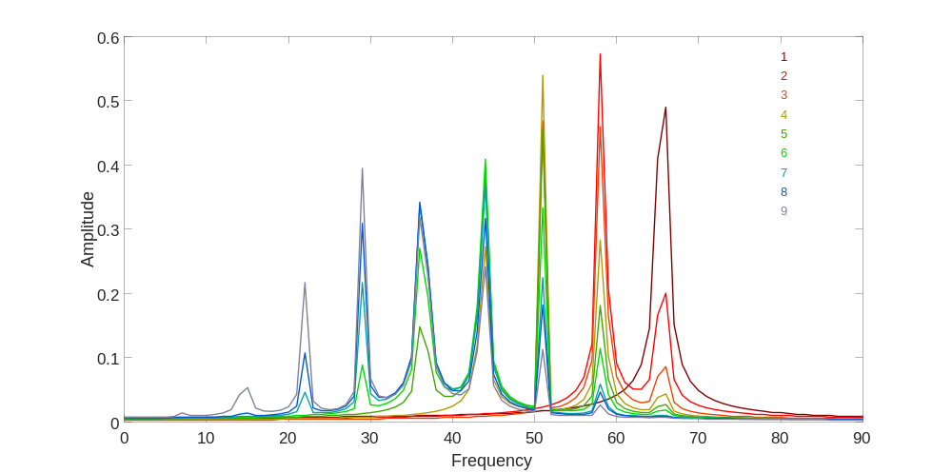
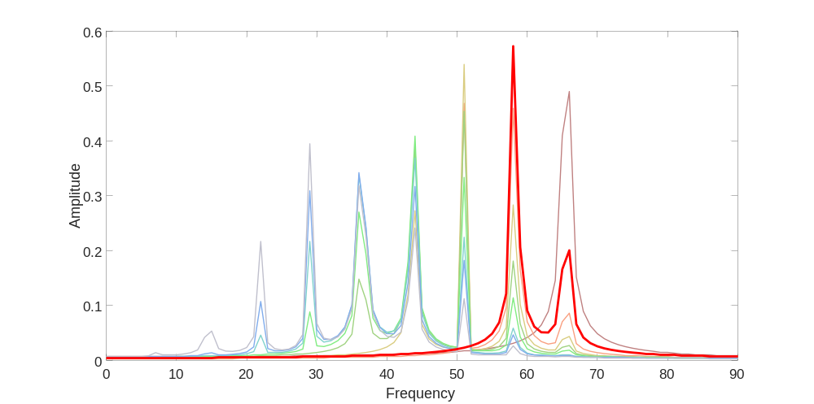
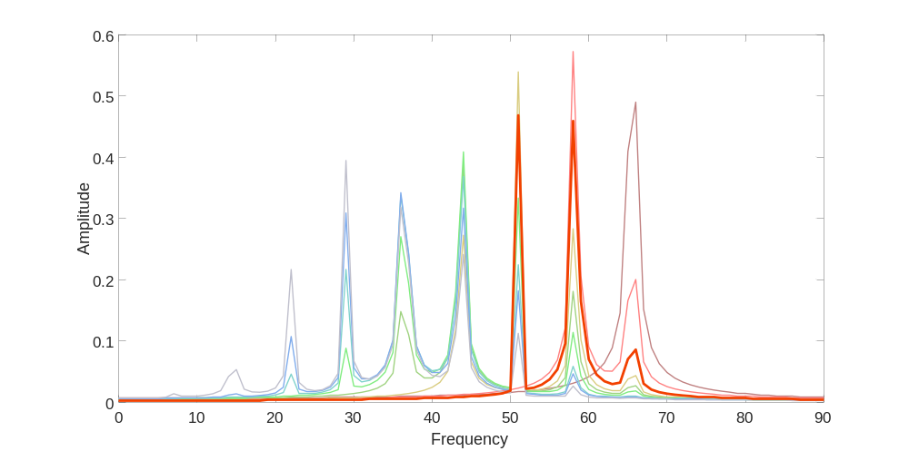
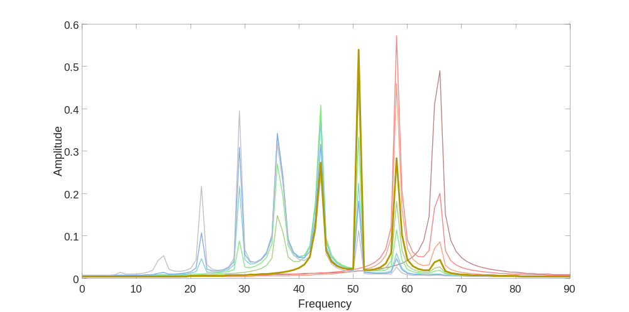
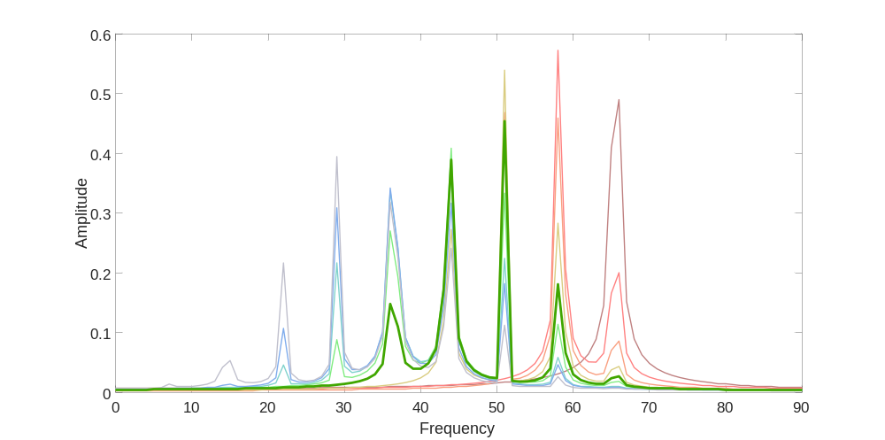
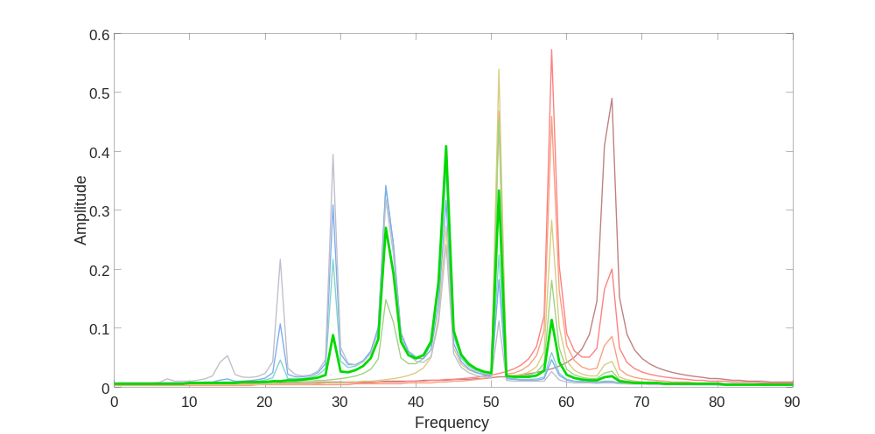
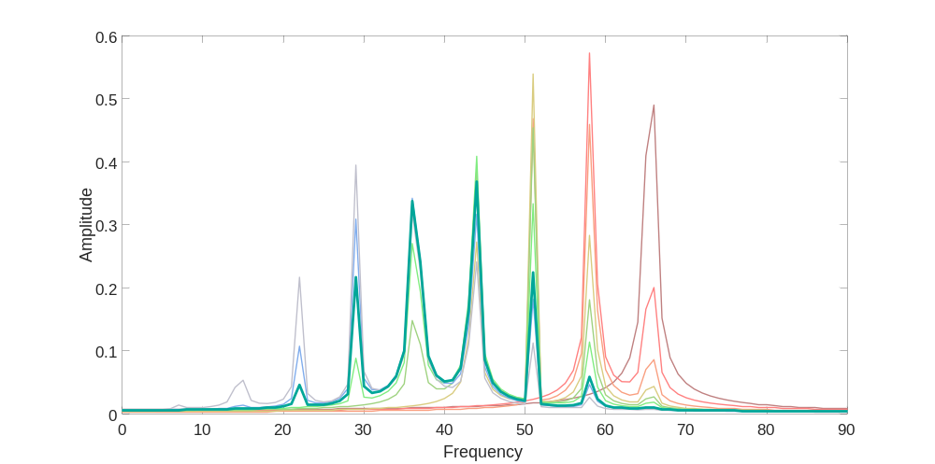
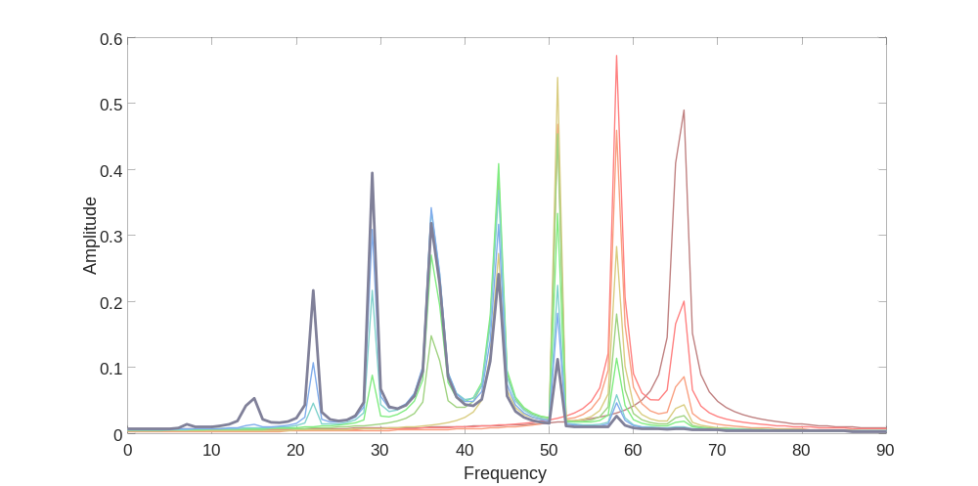
4 – Towards decoding: template matching via maximum correlation
Notes:
Last step.
Finally we are at the decoding stage.
It is quite common in neuroscience to assume that when you have a single trajectory (or burst of activity) this is classified according to its resemblance to the possibile patterns which are known to the network
So for every trajectory we indeed implement this search. We go in the library of templates and check whether the specific spectrum corresponding to the current simulation resembles or not to the templates stored in the library. The template which resembles most to the current data will win. And we make the simple assumption that, since the current singal resembles that template, the current INPUT is classified with the numberl label attached to that template

Slide 28

5 – Error estimate: confusion matrix

Slide 29

6 – Estimate judgment noisiness: 2-Alternative Forced Choice (2AFC)
i.e. how many times a stimulus wins competition vs. its numerosity
Psychometric function
Largest on the left
$$\frac{1}{2}\left[1+erf⁡\left(\frac{x−μ}{σ\sqrt{2}}\right)\right]$$
6
Numerosity on the left

Slide 30


7- Standard classical neuronal
activity model:
Mimicks brain response in a map of #nodes
Excitation profile
How: random in space and time

Slide 31
Numerosity perception:
existing models
Our coarse-grained
quantum model
Methods
Numerosity perception: phenomenology
Results

Slide 32



Weber ratio
Psychometric function
Stdv

Slide 33




Quantum model
vs.
Classical neuronal activity model

Slide 34
Designed a quantum mapping for information processing in the brain. In our model:
Strong signal of the number of past events persists after long time even with dissipation (if the network is all-to-all connected)
Numerosity perception is an intrinsic property of the quantum network, without any training
Even with our “agnostic” protocol, numerosity perception follows Weber’s law as derived from the psychometric function: this finding is robust with respect to time and space randomness and moderate dissipation levels
A minimal (single layer, minimal couplings but all-to-all, untrained ) Quantum model exploiting its intrinsic properties captures the qualitative behaviour and performs comparably – if not better - to idealized standard neuronal activity models
MESSAGES

Slide 35
QUESTIONS
Why all-to-all is essential: is there a deep reason?
Size effects and S/N ratio: while the size of the network should not count because of all-to-all couplings, what about the number of excitations? Hard with quantum to go beyond these sizes without approx.
Can we make it better with more complex quantum architectures (still simpler than classical ANN?)

Slide 36
QUESTIONS
Our quantum model is in fact a network of quantum clocks, whose dynamics and entanglement entropy might be analyzed under combined action of quantum + general relativity laws: see Dìosi-Penrose conjecture and Penrose-Hameroff theory of consciousness
Does model quantumness have implications on that of phenomena? Lower coarse graining towards microscopic description (see FMO)
SPECULATIVE

Slide 37
















Slide 38







































Slide 39
BACKUP SLIDES

Slide 40









Silvia Musolino
PhD@TU Eindhoven
with Servaas Kokkelmans
Davide Giambastiani
PhD@UniPi (exp!)
with Stefano Roddaro
Pietro M.Bonetti
PhD@Max Planck Stuttgart
Michele Barsanti
Researcher
@Engineering UniPi
Elvia Colella
PhD@Innsbruck
with Helmut Ritsch
Leonardo Lucchesi
PhD @UNIPI
In Phys+Eng
Cosetta Baroni
PhD@IQQT Innsbruck
(exp!) with Rudi Grimm
Fabrizio Varchetta
MD UNIPI now Project manager @Innolva
Silvia Trabucco
Now PhD @LNGS

Slide 41


Weber’s Law
Uncertainty is proportional to interval
A random emitter at worst yields Poisson regime

Slide 42



WHAT CAN WE MEASURE? PROBING THE QUANTUM SYSTEM
Experiments in visual perception rely on transient signals: no steady state
Magnetization = Excitation amplitude
+1 orientation: spike
–1 orientation: neuron at rest​
Large C Small C
Out-of-time ordered correlations:
encode the information spreading in the system
notion about the system’s “sense of time”​

Slide 43


QUENCH DYNAMICS: THE PROTOCOL
System evolves under the Hamiltonian (and dissipation)
2. Quench the system by introducing a spin flip (neuron spike)
3. System evolves and we measure magnetization and correlations
H
H
Questions:
​Do we observe changes in the dynamics?
How they depend on the governing parameters and on the time of the event(s)?
How extract time from the time signals?

Slide 44


WARM UP: ADDING ONE SINGLE EXCITATION
nearest neighbors all-to-all
Tunneling
Tunneling and interaction
Wider interaction
Tunneling, interaction and
particle loss

Slide 45

WARM UP: ADDING ONE SINGLE EXCITATION
nearest neighbors all-to-all
Tunneling
Tunneling and Mexican-hat interaction
Wider Mexican hat
Tunneling, interaction and
particle loss

Slide 46


QUANTUM DECOHERENCE
via particle loss
DEPHASING
leading to classical behavior
random sites
@
random times
Quantum decoherence
Dephasing
classical behavior

