Slide 1

On the emergence of Irreversibility in Quantum Systems
Marco Genovese
Quantum Hiking 2022
EU FET Open project - Pathos

Slide 2

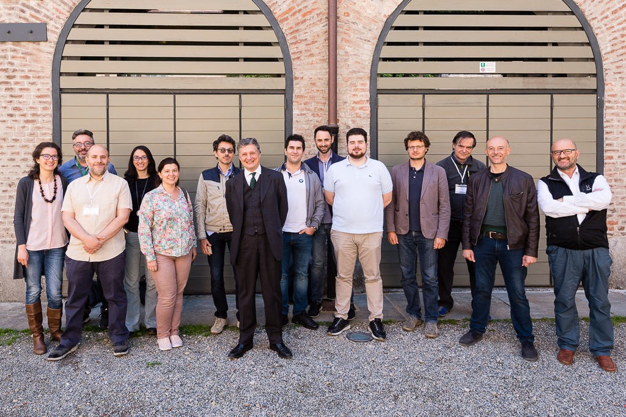



INRIM QUANTUM OPTICS GROUP
“Carlo Novero lab”
10 quantum optics labs
Permanent staff: M.G., A. Avella, E.Bernardi, I. Degiovanni, M.Gramegna, A.Meda, , E. Moreva, F. Piacentini, I.Ruo Berchera, F.Saccomandi, P. Traina
Non-permanent staff: P.Boucher, L.Knoll*,C.Napoli, E. Rebufello, S. Virzì
PhD students: M.Flaks, G.Ortolano, A.Paniate, G.Petrini, F.Picariello, Priyasheel, C.Stella
EU EMPIR project Polight
EU FET Open project - Pathos
V. Vedral
C. Marletto
Oxford Univ. , NSU

Slide 3
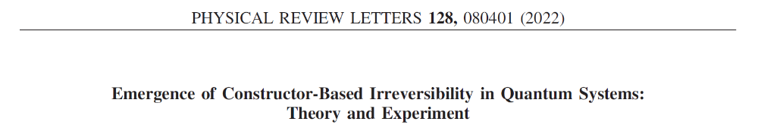
The emergence of irreversibility from time-symmetric physical laws is a central problem in contemporary physics.
Several approaches to irreversibility in physics:
Statistical mechanics methods
Information-theoretic descriptions of logically irreversible tasks
Classical and quantum thermodynamics second laws
In all such cases ->
tension arises between the laws describing irreversible phenomena, and the time-reversal symmetry of microscopic dynamics.
Here we express irreversibility, in the frame of constructor theory, as the requirement that a transformation is possible, while its inverse is not.

Slide 4
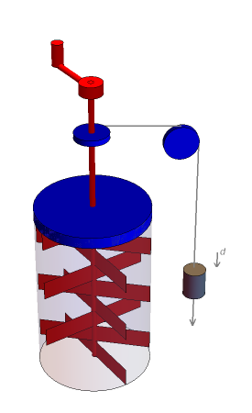
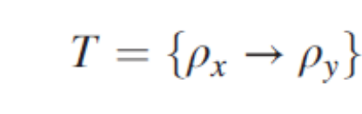
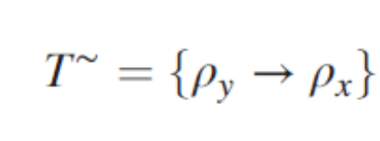
Joule's experiment
a volume of water can be heated up by mechanical means only, but it is impossible to cool it down by the same means
Constructor theory,
[C.Deutsch and C.Marletto, R.Soc.Pub. July 2014]
A few definitions
A task T is the specification of a physical transformation on qubits
Transposed task

Slide 5
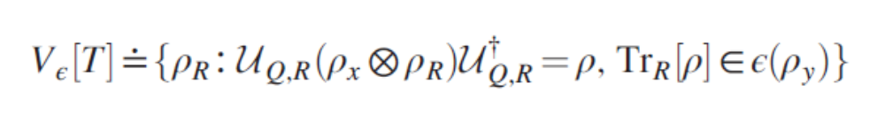

We will label the substrate qubit on which T is defined as Q, and the rest of the qubits as R.
A constructor for T on Q is some subsystem of R enabling T, without undergoing any net change in its ability to do it again.
A task is possible if there is no physical constraint on the accuracy to which a constructor can perform it, and impossible otherwise.
Constructor-based irreversibility is defined as the fact that, while T is possible, its transpose T∼ is not.
For a fixed task T on Q and an ϵ > 0, we define the set of quantum states of R that can perform T to accuracy 1 − ϵ

Slide 6
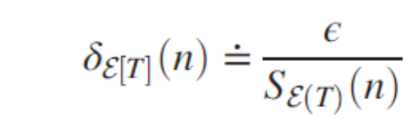
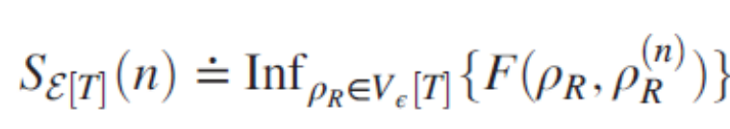
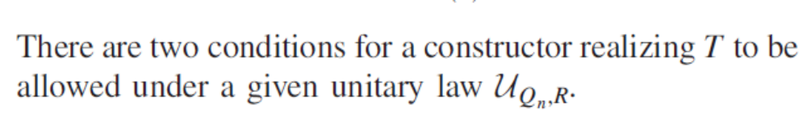

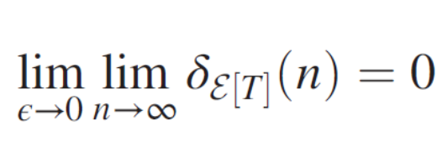
We must now introduce a measure of how the system can perform T after n- repeated usages to accuracy 1- ε
-> Relative deterioration after n usages
is not empty

Slide 7
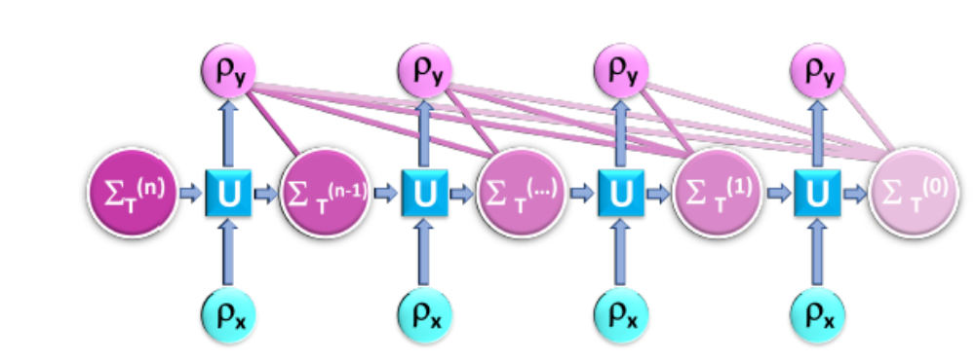
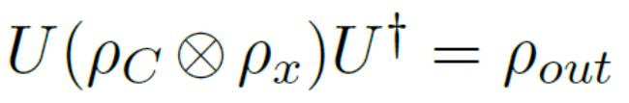

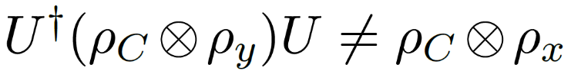
[from Marletto, Violaris, ArXiv 2205.11310]
One can have entanglement between system and machine after performoing task T
-> for the task T~ to be possible: any system with the attribute y should be transformed in the one with attribute x
By unitarity
But

Slide 8
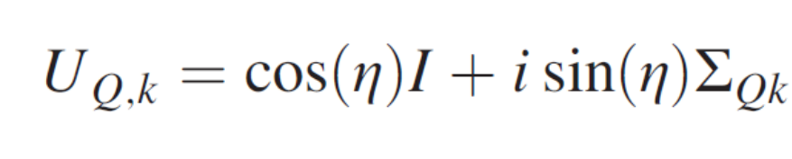
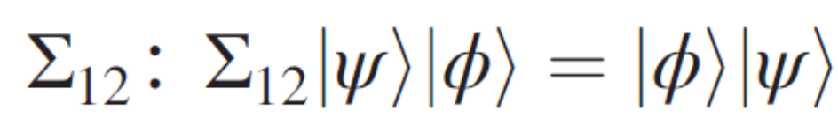
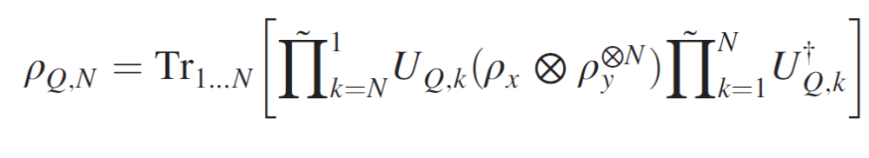
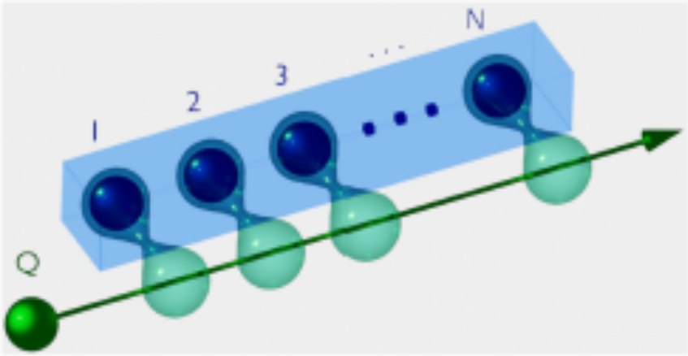
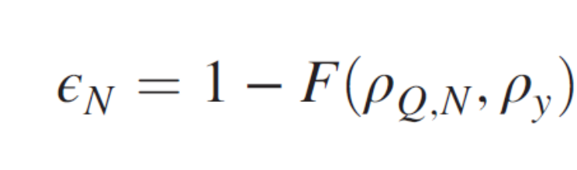
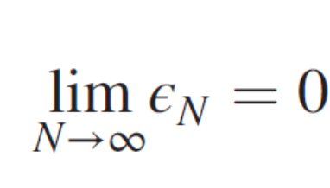
Let’s consider a quantum homogeneizer [M.Ziman et al., PRA 65, 042105 (2002)]
The «machine» performs perfectly the task for large N
-> condition (i) is satisfied

Slide 9
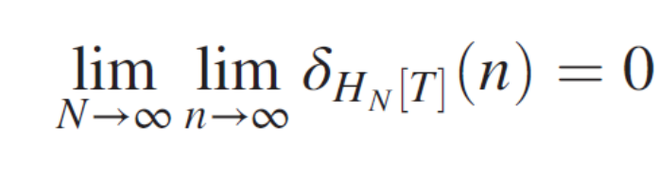
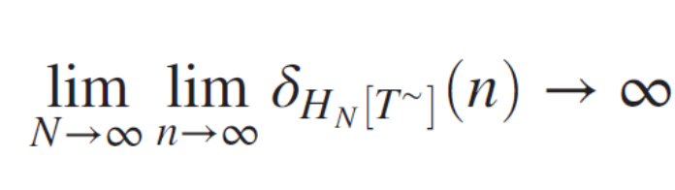
Consider the special case where ρ_{x} and ρ_{y} are, respectively, a pure and a maximally mixed state.
For small η
Good constructor for T
T being possible and the assumption of time-reversal symmetric laws do not imply that T~ must also be possible.
This makes constructor-based irreversibility compatible with time-reversal symmetric laws under unitary quantum theory.

Slide 10
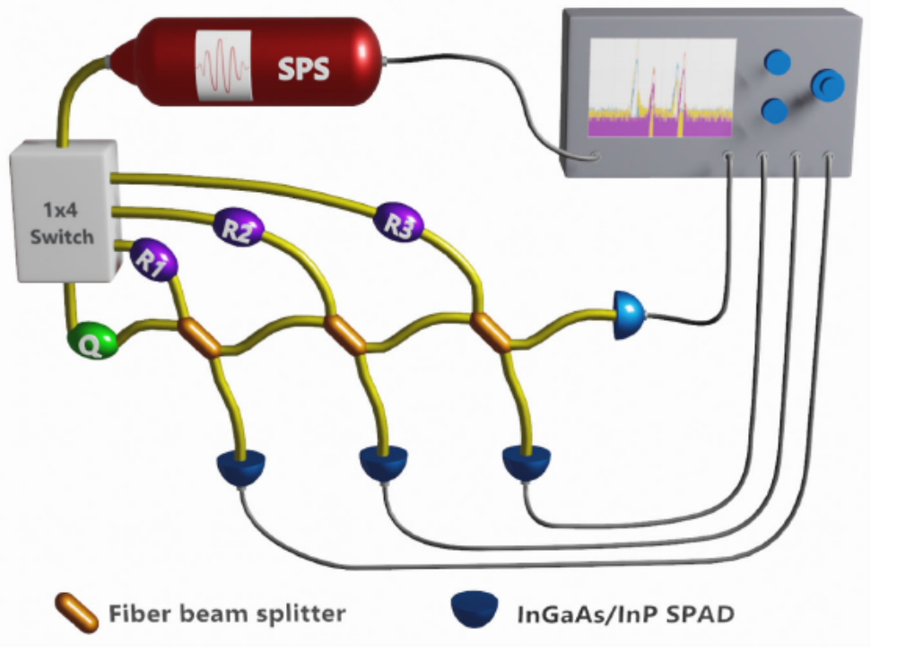
Constructure irreversibility at work: an experimental example
SPS G.Brida et al., Opt. Expr. 19, 1484- 1492 (2011); Appl. Phys. Lett. 101, 221112 (2012).

Slide 11

SMF
Dichroic
mirror
10x1x10 mm
PPLN
FC
IF
CW laser pump
λ/4
532
nm
IF
λ/2
1550 nm
FC
810 nm
λ/4
SMF
FPGA
Si-SPAD
Time-tagging
electronics
InGaAs
SPAD 1
InGaAs
SPAD 2
O
S
Pulse
Generator
SMF
SMF
FBS4
FBS5
1x4
switch
System
PS1
PS2
PS3
Hom 1
Hom 2
Hom 3
Notes:
Agents

Slide 12
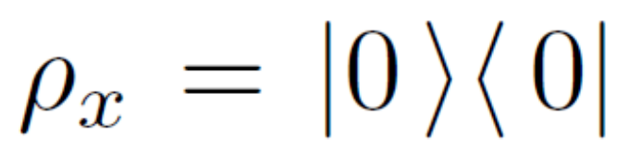
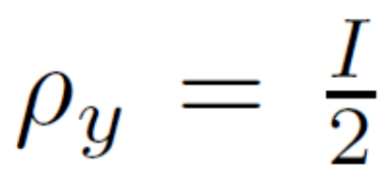
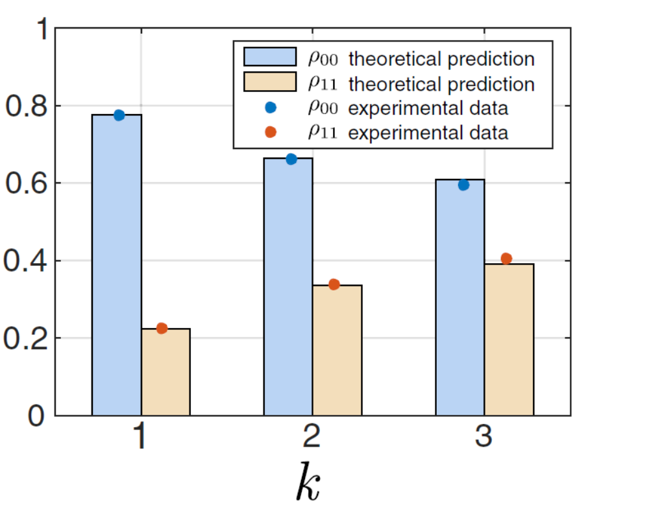
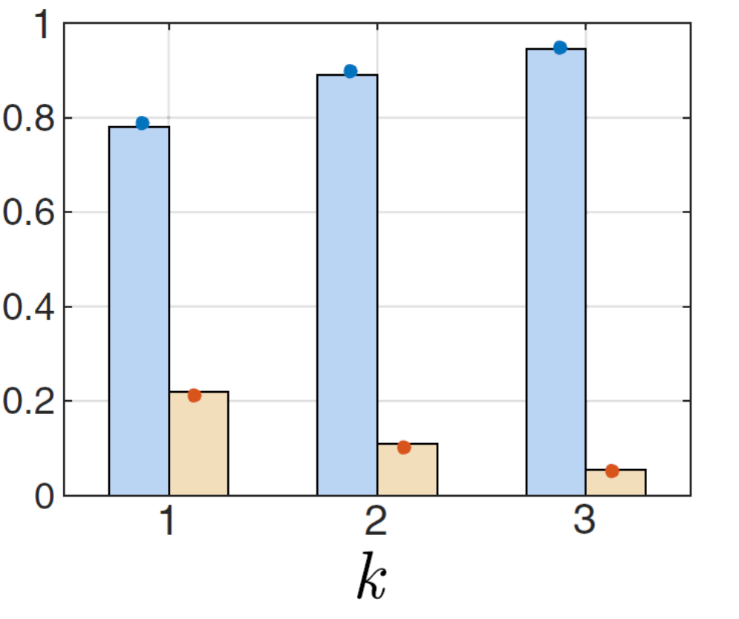
Pure to mixed
Mixed to pure

Slide 13
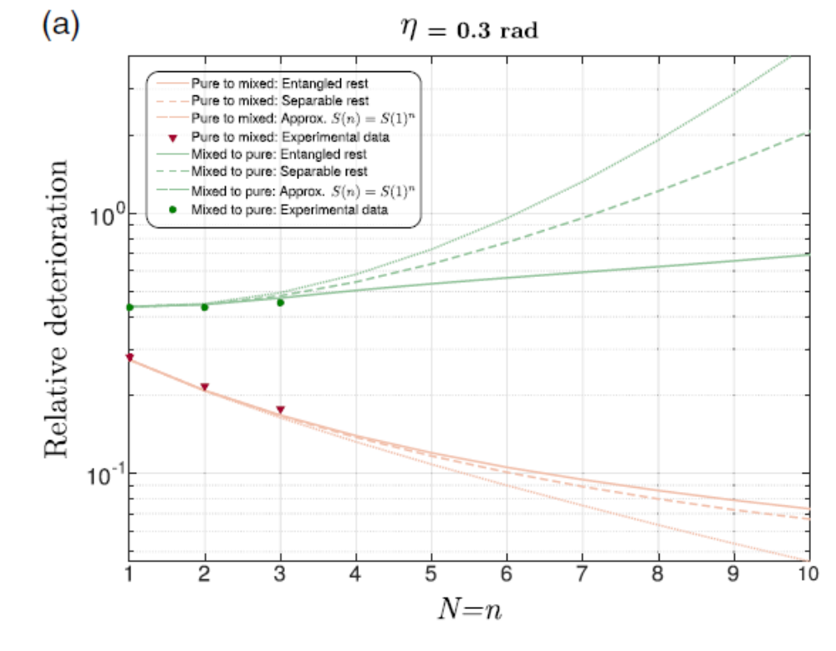

Slide 14
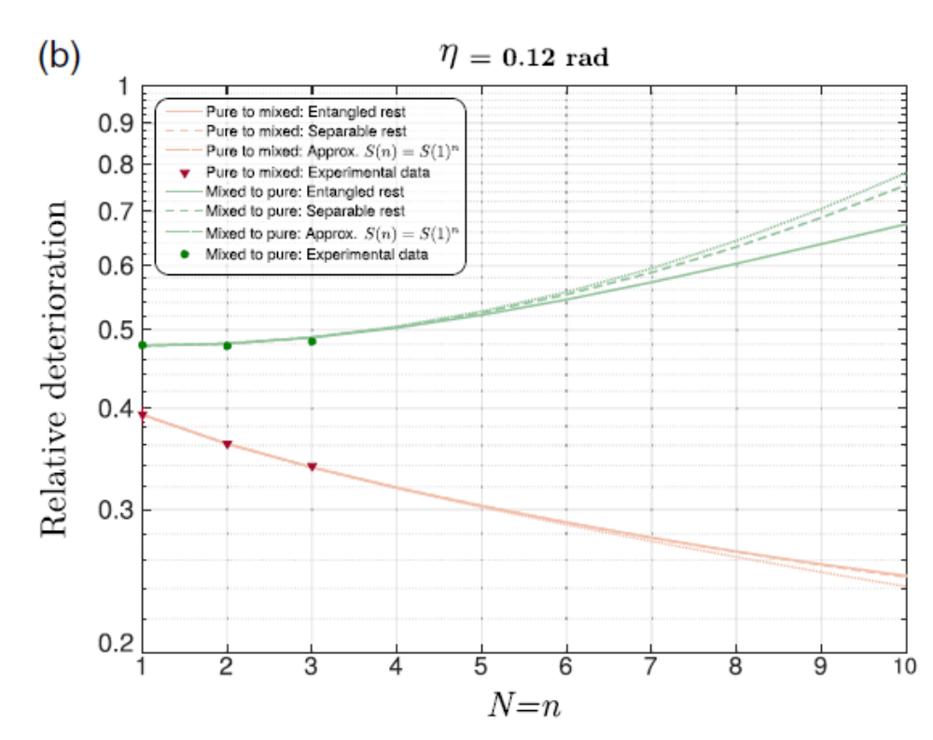

Slide 15
Our experimental results demonstrate that:
the homogenizer implementing T always outperforms its counterpart for the reverse task T∼,
the machine for T∼ suffers a much higher degradation than the one realizing T
ultimately not satisfying condition (ii) and thus failing to be a constructor.

Slide 16
Conclusions
Constructor theory provides a tool for explaining irrerversibility in QM
We performed an experiment showing this scheme at work.

